Slide 1


Customer Satisfaction of Airline Industry – Project 13
TEAM MEMBERS:
1. Harshini Balam
2. Neetu Aavula

Slide 2

Motivation Driving the Project:
Welcome to the Customer Satisfaction Analysis presentation. We'll delve into a comprehensive analysis of customer satisfaction using real-world data, aiming to extract insights and develop a predictive model to understand the key factors impacting satisfaction levels.
Project goal
To develop and evaluate machine learning models to predict customer satisfaction in the airline industry based on various features, using KNN and Naive Bayes algorithms.

Slide 3

Project Overview
Objective
Analyze customer satisfaction data and develop a predictive model to anticipate satisfaction levels, enabling businesses to optimize operations and enhance customer experiences.
Dataset
The "Customer Satisfaction dataset.csv" comprises 103,904 observations and 24 variables, providing rich information for our analysis.

Slide 4

Data Overview
Data Summary
The dataset includes customer demographics, travel details, service ratings, and satisfaction levels.
Key Variables
Age, gender, flight distance, type of travel, and class of service.

Slide 5
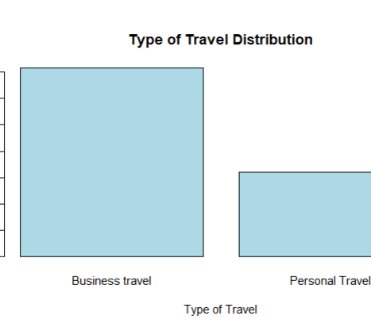
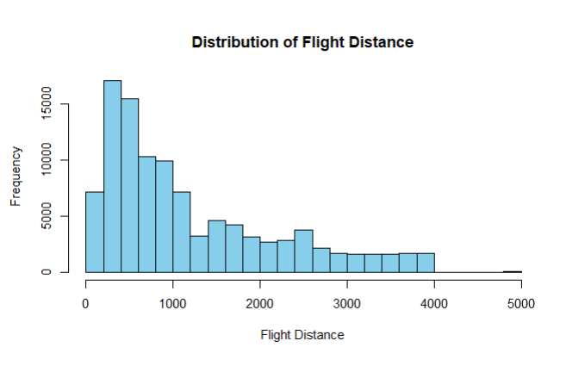
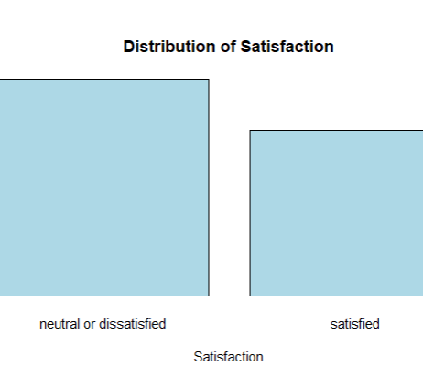
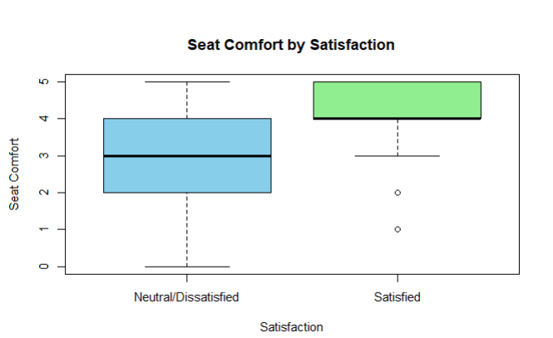
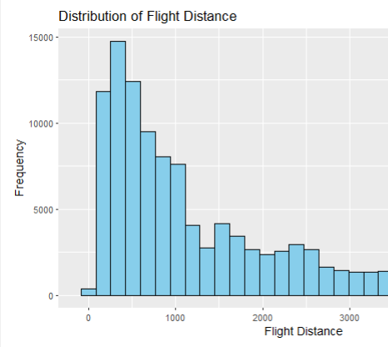
Data Visualization
Numerical Variables
Histograms to analyze central tendency, spread, and distribution.
Categorical Variables
Bar plots to visualize frequency distribution of categories.
Boxplot for Comparing Features by Satisfaction and Satisfaction Distribution

Slide 6
Data Preprocessing
1. Handling Missing values
The dataset does not contain any missing values, simplifying the preprocessing phase.
2. Encoding categorical variables
Convert categorical variables into numerical format using techniques like one-hot encoding. Convert categorical variables 'Type.of.Travel' and 'Class' into binary dummy variables.
3. Normalize Numeric Features
Normalize 'Flight. Distance' using Min-Max Scaling to scale values between 0 and 1.

Slide 7
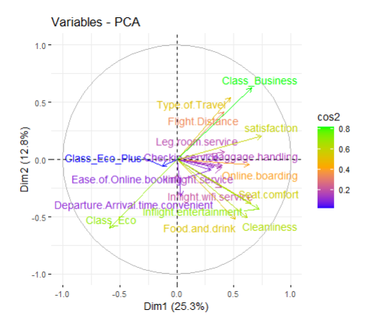
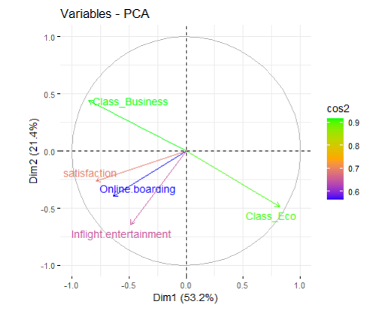
Feature Selection and PCA Visualization
Dimensionality Reduction with PCA
Identify the features you want to keep. Subset the dataset to keep only the selected features

Slide 8
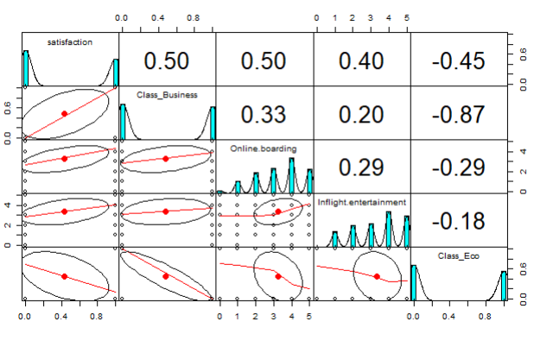
Pair Metrix
Pair Plot
The image shows a pair plot of 4 variables: satisfaction, class, online boarding, and inflight entertainment. The pair plots show the relationship between each pair of variables.

Slide 9
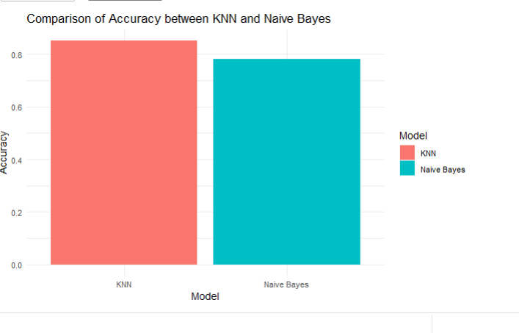
Classification Model Selection
Model 1 - KNN Model
Performing the classification model with the KNN model. Building the model after determining the Hyper parameter as K .
Model 2 – Naïve Bayes Model
Performing the classification model with the Naïve Bayes.
Model Performances
Comparing both the models KNN and Naive Bayes to know the best Fit. The KNN model has an accuracy of about 0.8, while the Naive Bayes model has an accuracy of about 0.6. This means that the KNN model is more accurate than the Naive Bayes model.

Slide 10

Conclusion
The K-Nearest Neighbors (KNN) model performed well in analyzing customer satisfaction within the airline industry, particularly when considering the optimal K value. Through cross-validated resampling, the model's accuracy and kappa statistics peaked at K = 11, indicating its ability to generalize effectively while avoiding overfitting. This highlights the KNN model's robustness in predicting customer satisfaction, offering valuable insights for improving airline services and enhancing overall customer experience.

Slide 11
THANK YOU

